Slide 1




Project 2 YouTube Song Analysis
By Jigar Patel

Slide 2
Problem Statement
In today's digital content consumption market, YouTube stands out as a leading medium for music distribution, gathering millions of users every day. However, in this large sea of information, discerning valuable data into YouTube songs' performance, popularity, and user interaction is a daunting task for both content providers and stakeholders.
The vast amount of data related with YouTube songs, spanning from video properties to audience interactions, needs a methodical approach to research and interpretation. The project aims to address this difficulty by doing a detailed analysis of YouTube song data using Power BI's advanced capabilities.
Notes:
YouTube is a major hub for music distribution, but navigating the vast amount of data on song performance and user interaction can be daunting. This project aims to analyze YouTube song data using Power BI to provide valuable insights for content creators and stakeholders.

Slide 3
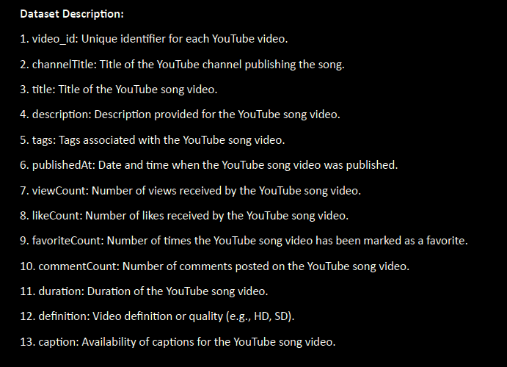

Dataset Description

Slide 4
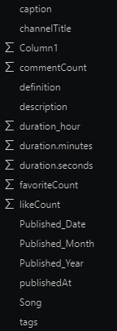
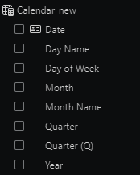
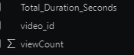

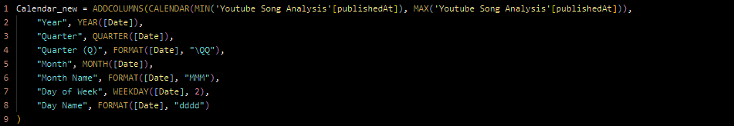









About Data
The dataset comprise total 19,345 records with 13 different attributes.
Only “description” column contain null value which is filter out and replace them with “None”.
Here couple of columns are split and distributed by specific column which is highlighted in the picture
For further analysis, I created table “Calender_new” using DAX

Slide 5
Data Processing
Remove Null Values and Filter Data:
Remove null values from the Description column.
Filter out unnecessary data from the Description column.
Split Description Column and Create 'Song' Column:
Split the Description column which contains song names.
Create a new column named "Song" to store the song names.
Split ‘PublishedAt’ Column and Modify Datatypes:
Split data in the PublishedAt column into date and time.
Change the datatype of the date column to date from date/time.
Further split data into Published_Year, Published_Month, and Published_Day.
Split Duration Column and Create Time Components:
Split data in the Duration column into hour, minute, and second.
Create Custom Column 'Total_Duration_Seconds':
Generate a custom column named "Total_Duration_Seconds" using a query.

Slide 6



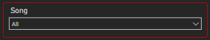

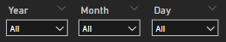
Slicers & Buttons Used in Dashboard
Home Button navigate to Main Dashboard
Reset Button to Reset all Slicers
Dropdown for List of Songs
Slider for Years
Dropdown for List of Years, Months and Days

Slide 7
Dashboard 1 Main Dashboard

Slide 8
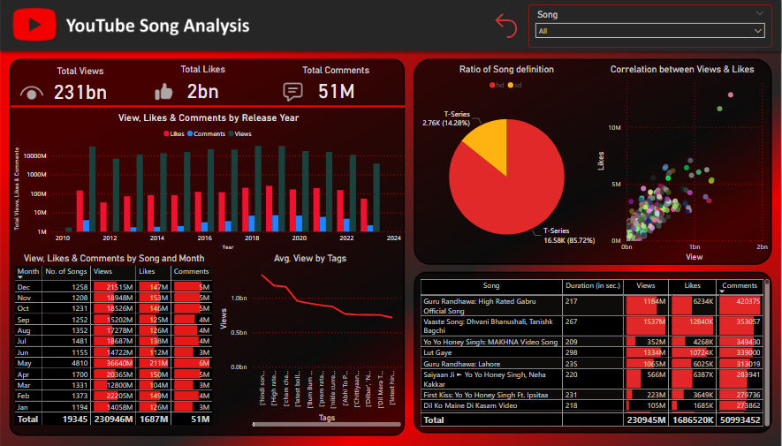

Slide 9
Dashboard 2 Yearly Distribution

Slide 10
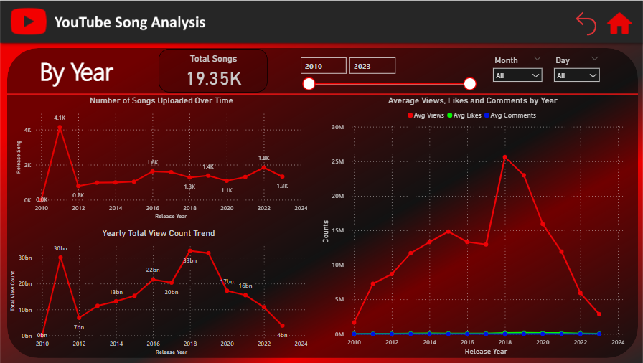


Slide 11

Dashboard 3 Top 5 Distribution

Slide 12
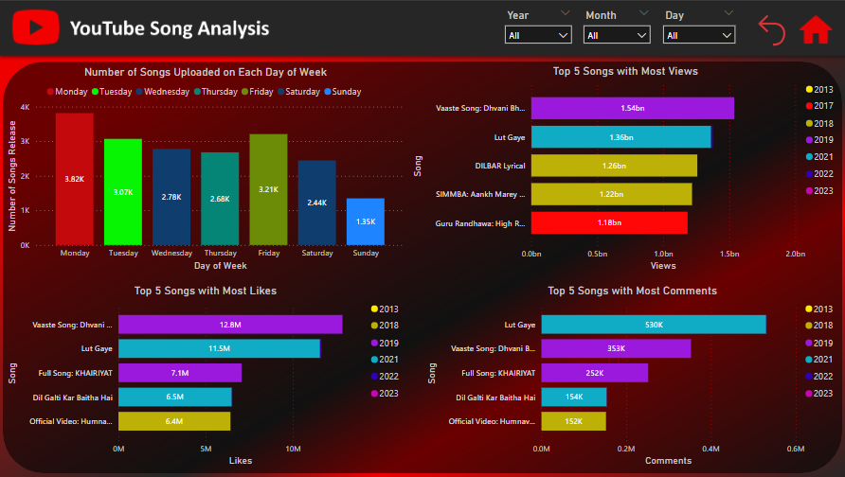


Slide 13



Total Songs: 19.35K (in thousand)
Total Views: 231bn (in billion)
Total Likes: 2bn (in billion)
Total Comments: 51M (in million)

Slide 14
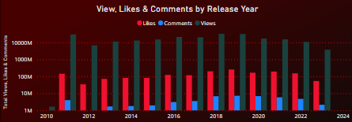
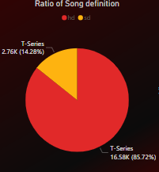

The graph illustrates the distribution of Views, Likes, and Comments by the release year.
It emphasizes the year where the ratio of Views is the highest, Likes proportion is half the ratio of Views, and Comments ratio is notably less than the other two categories.
The chart depicts video definitions by channel, focusing solely on T-Series.
It showcases the distribution between HD and SD definitions.
Notably, HD videos comprise approximately 86% of the total, while SD videos constitute a mere 14.28%.

Slide 15
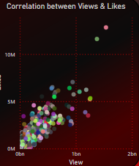
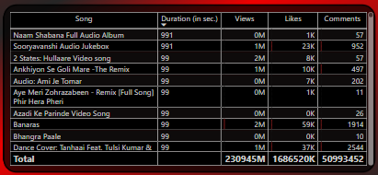

The scatter plot illustrates the correlation between views and likes.
It reveals a clear positive correlation between the two variables.
As views increase, likes also tend to increase, indicating a positive correlation.
The data points on the scatter plot cluster in an upward direction, affirming this trend.
The table offers insights into song names, total duration in seconds, views, likes, and comments.
Stakeholders can easily access and analyze pertinent information directly from the table.

Slide 16
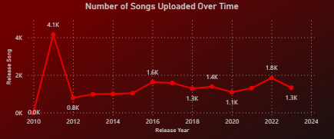
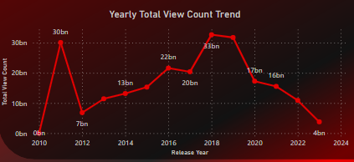

The line chart illustrates the evolution of video uploads over the years, with a notable peak in 2011 surpassing 4.1K uploads.
Surprisingly, the trend of uploading video songs shows a consistent decline over time, reaching a mere 1.3K uploads by 2023.
The line chart depicts the evolution of video view counts over time.
In 2011, views peaked at 30 billion, but experienced a sharp drop to 7 billion the following year.
Subsequently, there was a continuous increase, reaching over 33 billion in 2018.
However, after 2018, views steadily decreased, plummeting to 4 billion by 2023.

Slide 17
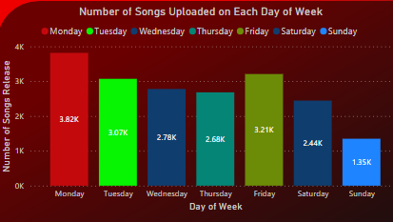
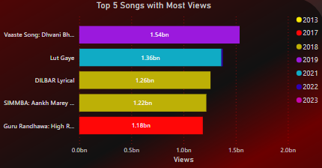

The bar graph reveals that Monday sees the highest number of video uploads, approximately 3.82K.
Tuesday and Friday follow closely as the second most popular days for video song uploads.
Surprisingly, Sunday shows the least activity with only around 1.35K video uploads according to the analysis.
The graph depicts the top 5 songs with the highest views.
"Vaaste" by Dhvani Bhanushali and Tanishk Bagchi leads with 1.54 billion views in 2019.
Following are "Lut Gaye" (1.36B in 2021), "Dilbar" (1.26B in 2018), "Ankh Marey" (1.22B in 2018), and "High Rated Gabru" (1.18B in 2017).

Slide 18
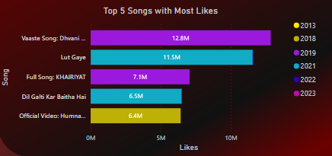
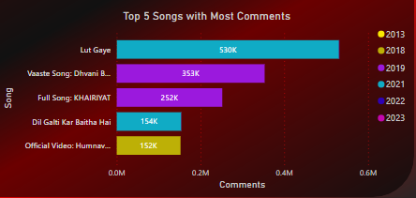

Likes (Left Side):
"Vaaste" leads with 12.8 million likes in 2019.
Followed by "Lut Gaye" with 11.5 million likes in 2021.
"Khairiyat" received 7.1 million likes in 2019.
"Dil Galti Kar Baitha Hai" garnered 6.5 million likes in 2021.
"Humnava Mere" accumulated 6.4 million likes in 2018.
Comments (Right Side):
"Lut Gaye" ranks first with 530k comments in 2021.
"Vaaste" received 353k comments in 2019.
"Khairiyat" garnered 252k comments in 2019.
"Dil Galti Kar Baitha Hai" accumulated 154k comments in 2021.
"Humnava Mere" received 152k comments in 2018.

Slide 19

Revealing YouTube's Song Analysis Insights
In summary, the examination of YouTube song data illuminates' significant trends and patterns essential for understanding musical preferences and audience engagement.
During the period from 2010 to 2023, likes consistently accounted for 0.86% of total views (2 billion), while comments constituted a mere 0.02% (51 million).
In our analysis, May month stands out with 4,810 song releases, accumulating 36,640 million views, 211 million likes, and 6 million comments. It could be considered the mid-season point for song activity.
T-Series' 'Harmonious Himesh - 101 Hits Of Himesh Reshammiya' holds the record as YouTube's longest video, spanning 8 hours, 54 minutes, and 51 seconds. Additionally, there are 7 short videos, each 7 seconds in length.
In 2011, most songs uploaded amounted to approximately 4.1K, whereas in 2012, the number significantly decreased to around 0.8K.
The year 2018 proved to be exceptionally fortunate for song makers, boasting a grand total proportion of approximately 25 million views, 157K likes, and 5K comments.
Monday sees a high upload rate of around 3.82K videos, signifying the start of the work week.
The song 'Vaaste' by Dhvani Bhanushali and Tanishk Bagchi reigns as one of YouTube's most popular tracks, boasting 1.54 billion views and 12.8 million likes.

Slide 20

Outcome Highlights
Successfully managed a dataset comprising 19,345 records and 13 attributes, ensuring data integrity and quality.
Demonstrated proficiency in creating dynamic DAX queries tailored to specific analytical needs.
Utilized advanced features in Power BI, such as slicer syncing, to enhance dashboard interactivity and user experience.
Developed interactive dashboards with Key Performance Indicators (KPIs) and visually appealing graphics for easy data interpretation and decision-making.

Slide 21



Thank You

